Slide 1
Cracking the Facebook
Coding Interview
I <3 Facebook!
CareerCup

Slide 2
Why am I here?
00

Slide 3
Why would Facebook prep you?!?
Be more comfortable
Be more prepared
be YOUR best
Avoid common mistakes
Take out
the mystery

Slide 4






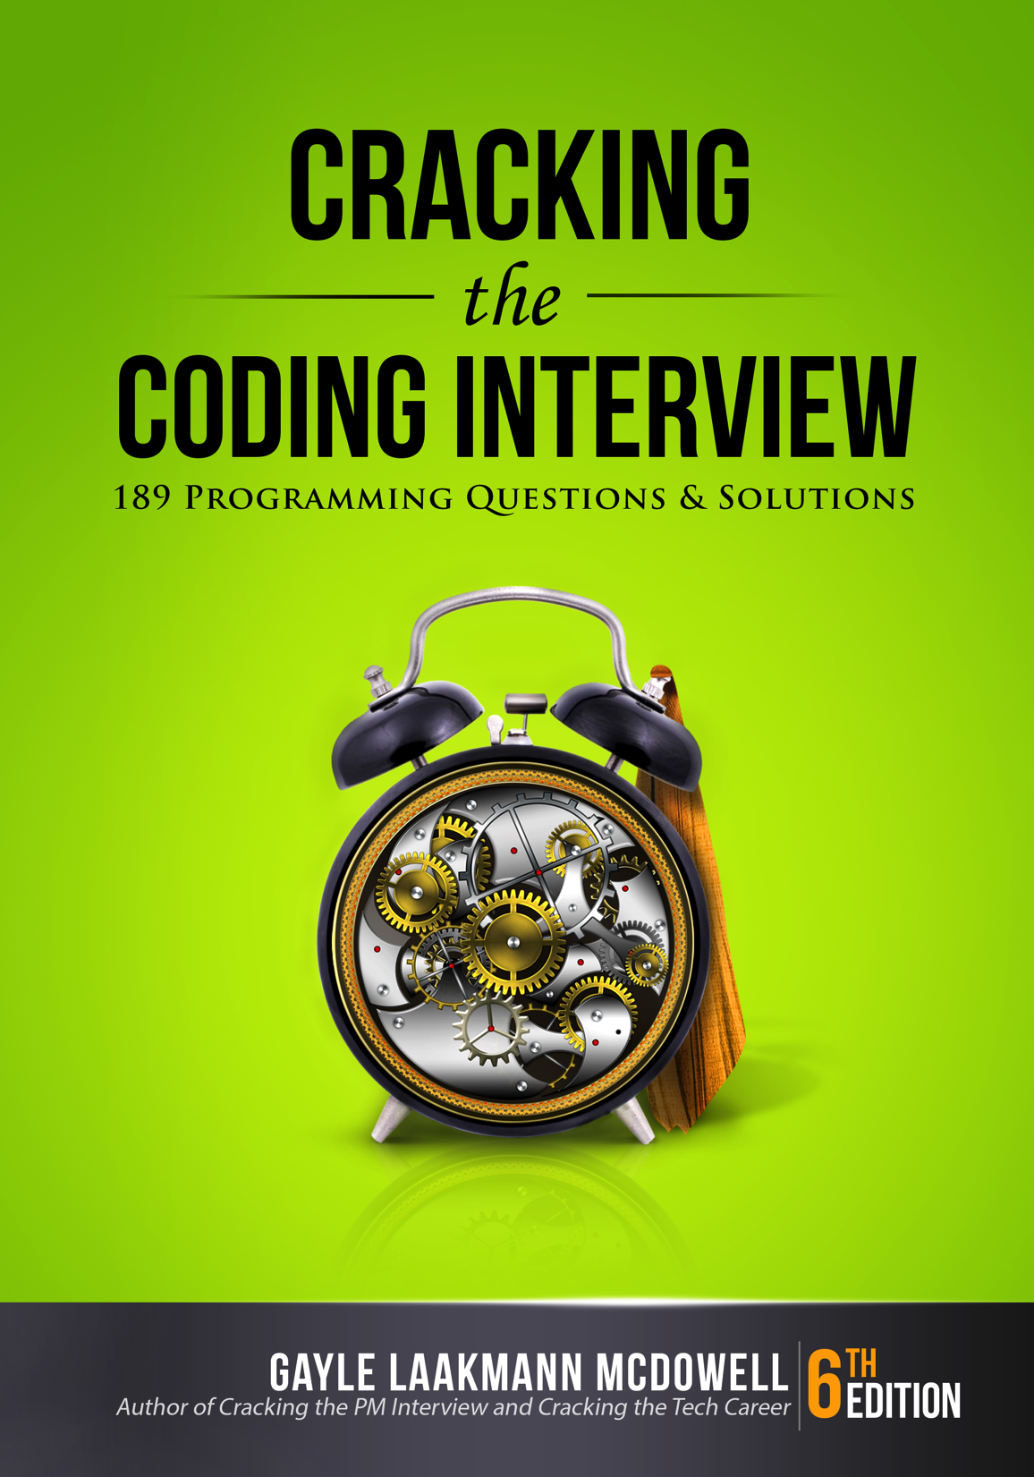
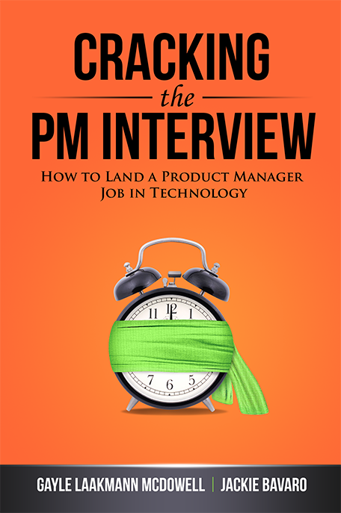



Hi! I’m Gayle Laakmann McDowell
(CS)
(MBA)
<dev>
</dev>
Author
Interview Coach
Interview Consulting

Slide 5


Yes! Slides are online!
Gayle.com
Click “Events”
Ctrl-F for “Facebook”
Email: g@gayle.com Subject: fbprep

Slide 6
Email: g@gayle.com Subject: fbprep
What to Expect

Slide 7
A Typical** Process (**not universal! Ask your recruiter)
Phone
Onsite
Hiring Committee & Decision
Algo / Coding
½ Behavioral
½ Algo / Coding
Design
Algo / Coding
Algo / Coding

Slide 8
5 Minutes
Prior Experience
35 Minutes
Question #1
Question #2
5 Minutes
Questions FOR Interviewer
Typical
Coding
Interview

Slide 9
5 Minutes
Prior Experience
35 Minutes
Question #1
5 Minutes
Questions FOR Interviewer
Typical
Design
Interview

Slide 10
Email: g@gayle.com Subject: fbprep
Behavioral Questions
02
The soft squishy stuff.

Slide 11
The Pitch / Resume Walk-Through
I’m a software engineer at ...
My background’s in CS.
At my current company, I …
Outside of work I …
I studied at UPenn and then…
Shows of success
Prompt the interviewer
Hobbies

Slide 12
Your Past Work
3+ Projects
Hard / cool
You were central
Technical depth
All Past Work
TECHNICAL: Challenges, architecture, tradeoffs, successes, motivations
SOFT: Teamwork, leadership, conflicts, etc
What did YOU do?
What would you do differently?

Slide 13
Be PASSIONATE
What
Be KNOWLEDGEABLE
about
YOU?
Be a GOOD TEAMMATE

Slide 14
Email: g@gayle.com Subject: fbprep
Design Questions
03
Big, meaty problems

Slide 15
W
W
Y
D
A
W
hat
ould
ou
o
t
ork
How
To
Approach

Slide 16
S
K
I
R
cope
ey components
dentify issues
epair
How
To
Approach

Slide 17
Scope the Problem
Ask questions
Make appropriate assumptions
Define Key Components
Can be somewhat naïve
Identify Issues
Bottlenecks, tradeoffs
Repair & Redesign
How
To
Approach
Breadth-first, not depth-first

Slide 18
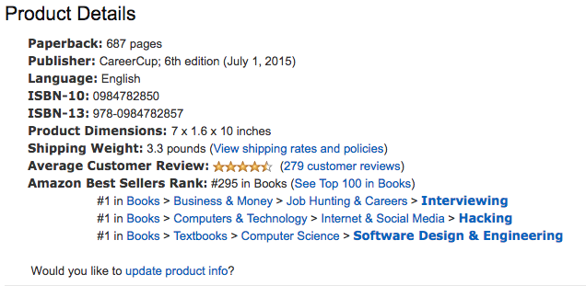
Example Question

Slide 19
Design sketch
logger
Frontend
Backend
Data store

Slide 20
Collaborative discussion that you’re driving!
DRIVE
Lead the process
Be open about issues
TEAMWORK
Be open to feedback
Tweak as necessary
Use the whiteboard!

Slide 21
Read about design of major companies
THINK, don’t memorize!
Know key concepts
Tasks, sharding, caches.
Web stack, REST, etc
Practice back-of-the-envelope calculations
How
To
Prepare

Slide 22
Email: g@gayle.com Subject: fbprep
Algorithm Questions
04
Things that make you think

Slide 23
Why?
Analytical skills
How you think
Make tradeoffs
Push through hard problems
Communication
Strong CS fundamentals

Slide 24
Essential Knowledge
Data Structures | Algorithms | Concepts
ArrayLists | Merge Sort | Big O Time
Hash Tables | Quick Sort | Big O Space
Trees (+ Tries) & Graphs | Breadth-First Search | Recursion
Linked Lists | Depth-First Search | Memoization / Dynamic Programming
Stacks / Queues | Binary Search
Heaps

Slide 25
Preparation
MASTER Big O
Implement DS/Algorithms
Practice with interview questions
Code on paper/whiteboard
Mock interviews
PUSH YOURSELF!

Slide 26
Email: g@gayle.com Subject: fbprep
A Crash Course in Big O
Just getting your feet wet

Slide 27
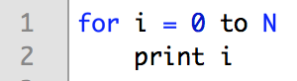
Basic for loop
Print 0 through N
Runtime?
O(N)

Slide 28
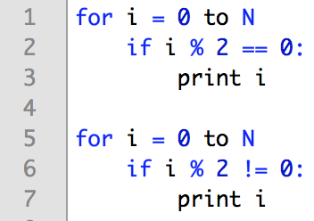
Two loops
Print evens, then odds
Runtime? O(N)

Slide 29
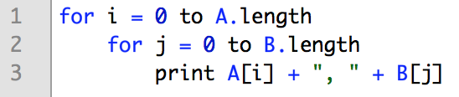
Basic for loop
Print pairs from two arrays
Runtime?
O(A * B)

Slide 30
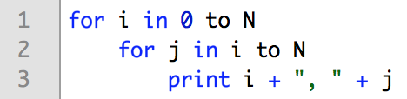
Basic for loop
Print ordered pairs
Runtime?
O(N²)
 | j : 0 → N
i : 0 → N | x | x | x | x | x | x
 |  | x | x | x | x | x
 |  |  | x | x | x | x
 |  |  |  | x | x | x
 |  |  |  |  | x | x
 |  |  |  |  |  | x

Slide 31
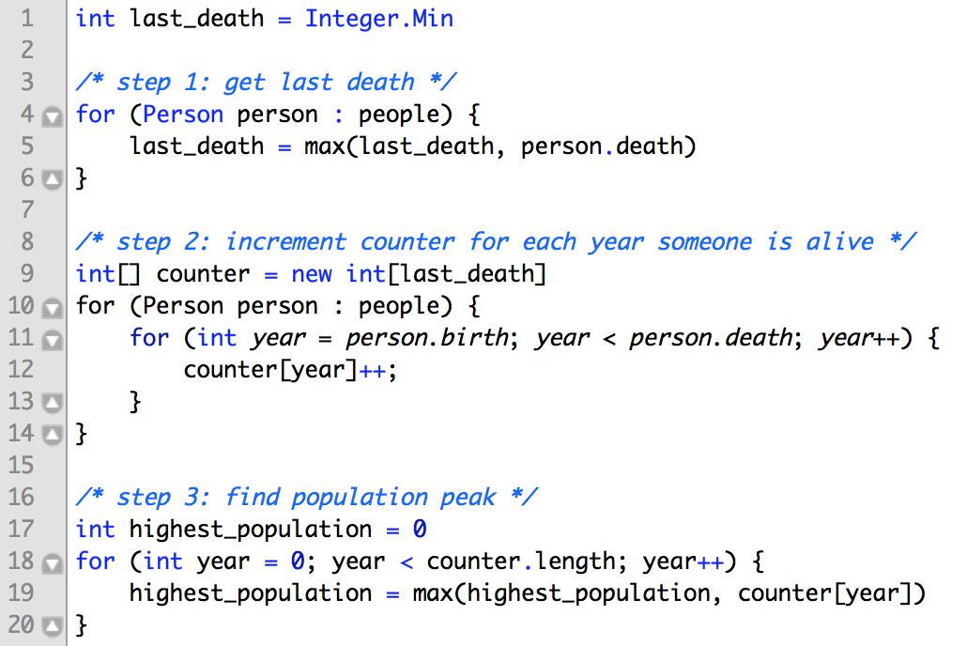
Okay now things are getting tougher!

Slide 32
Okay now things are getting tougher!
Step 1: O(P)
P = number of people
Step 2: O(P * Y)
Y = max life span
Step 3: O(L)
L = last death year
O(P + P * Y + L) → O(P * Y + L)

Slide 33
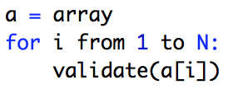
Validate
Validate
Runtime?
undefined

Slide 34
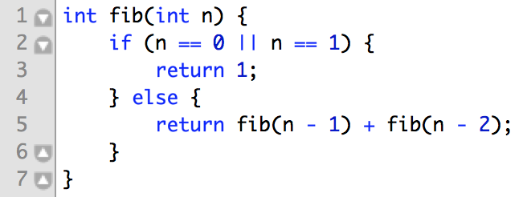
Eeek. Recursion?
Fibonacci
Runtime?

Slide 35
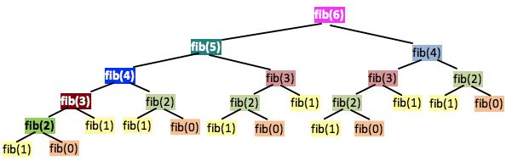
Eeek. Recursion?
Height of N
Each level doubles # nodes
→ O(2^{N}) time ***
→ O(N) space
Actually slightly less for complex math reasons.
Fibonacci

Slide 36
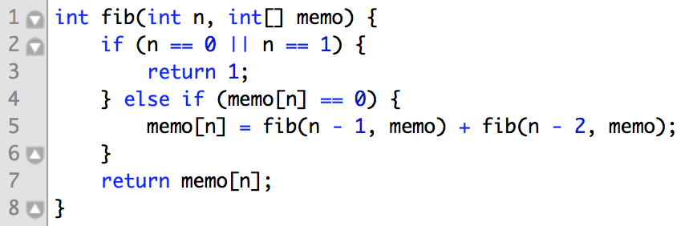
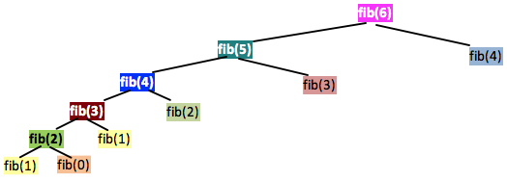
Eeek. Recursion?
Fibonacci, part 2
Runtime?
Height of N
Each level has <= 2 nodes
→ O(N) time
→ O(N) space

Slide 37
Reminders
Drop constants
Don’t drop non-constants
Different variables
Avoid ‘n’
Add vs. Multiply
Recursion call tree

Slide 38
Email: g@gayle.com Subject: fbprep
Solving Algorithms
How to… attempt to solve a hard problem

Slide 39
To know the answers
To solve immediately
To code perfectly
What
is NOT
(It’s nice. It just doesn’t happen*.)
expected
* Okay fine. It happened once, in 2000+ hiring packets.

Slide 40
Be excited about hard problems
Drive!
Keep trying when stuck
More than just “correct”
Pay attention to me!
Write real code
What
IS
expected
Show me how you think!

Slide 41
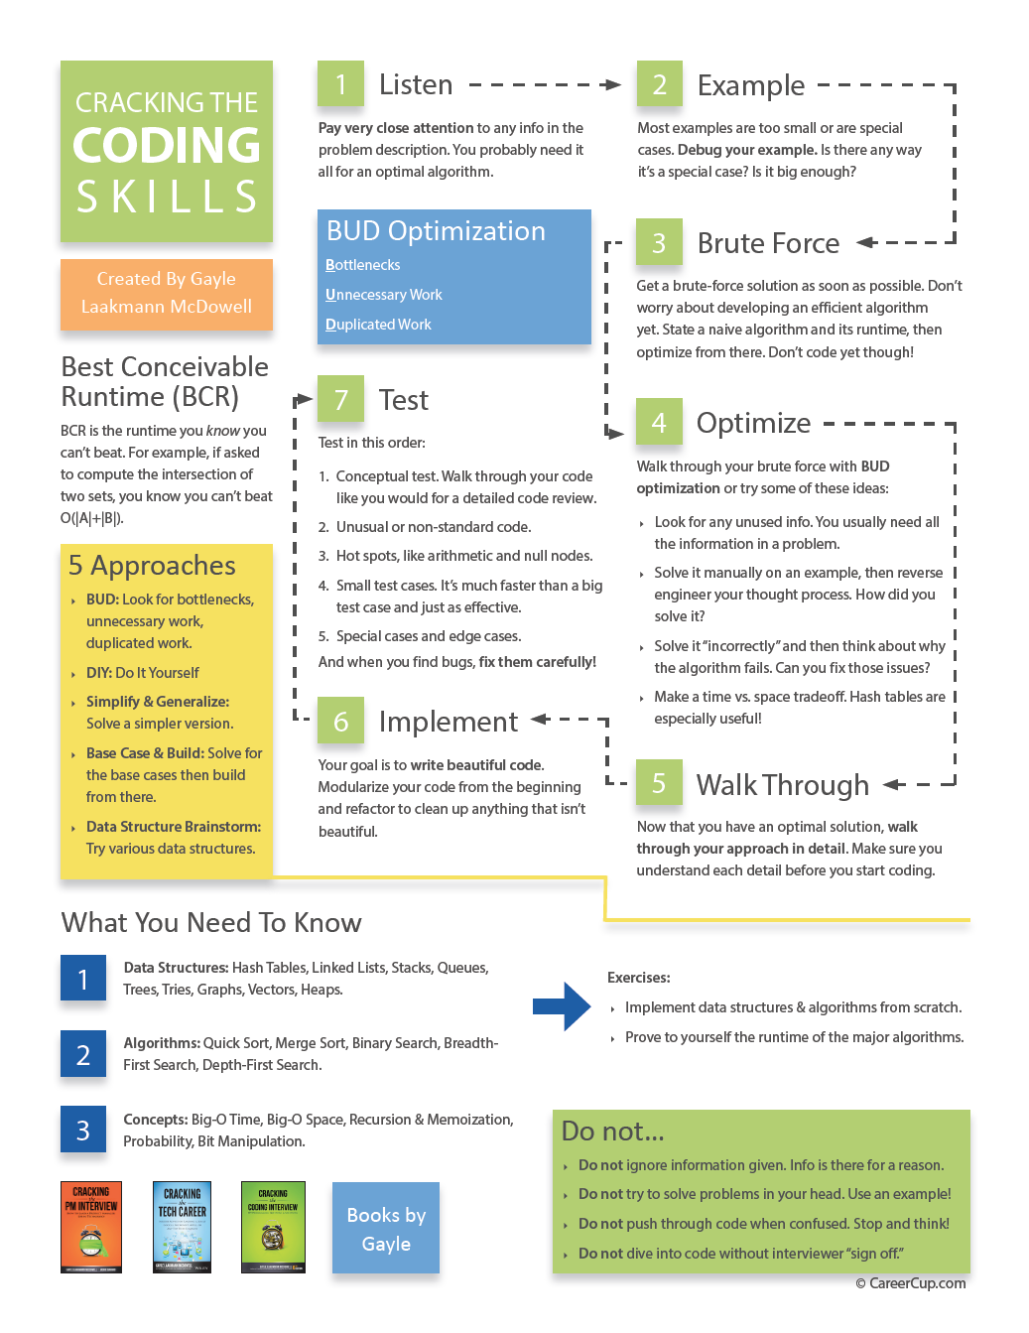
How
To
CrackingTheCodingInterview.com → “Resources”
Approach
Email: g@gayle.com Subject: fbprep

Slide 42

Listen (for clues)
step
1

Slide 43
What’s the clue?
Anagram server
Ex: rates -> aster, stare, taser, tears
Clue: why is it on a server?
Key (sorted string) | Value (list of words)
aerst | rates, aster, stare, taser, tears,
dgo | dog, god
acll | call
… | …

Slide 44
Draw an Example
INTERSECTION SIZE: Find # elements in common between two sorted, distinct arrays:
step
2

Slide 45
Ex: Intersection of Two Sorted Arrays
Most people draw something like this:
[1, 12, 15, 19]
[2, 12, 13, 20]
Too small
Too special-case-y
same size, one common element, same index

Slide 46
Ex: Intersection of Two Sorted Arrays
Better:
[1, 12, 15, 19, 20, 21]
[2, 15, 17, 19, 21, 25, 27]
Big
No special cases

Slide 47
Draw an Example
Big Enough
step
2
+
General Purpose

Slide 48
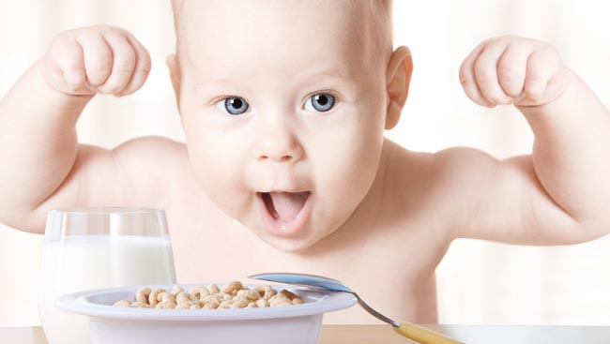
Brute Force / Naive
step
3
Stupid & terrible is okay!

Slide 49
Optimize
step
4
Walk through brute force
Look for optimizations

Slide 50
Techniques to Develop Algorithms
BUD
Space and Time
Do It Yourself
Recursion
Push yourself!

Slide 51
(A) Look for BUD
Bottlenecks
Unnecessary work
Duplicated work

Slide 52
What’s the bottleneck?
Ex: counting the intersection
[1, 12, 15, 19, 20, 21]
[2, 15, 17, 19, 21, 25, 27]
Bottleneck: searching
B

Slide 53
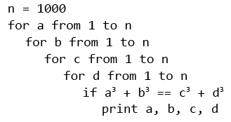
What’s unnecessary?
Ex: a³ + b³ = c³ + d³ (1 <= a, b, c, d <= 1000
Unnecessary: looking for d
U

Slide 54
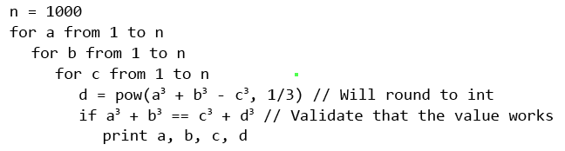
What’s unnecessary?
Ex: a³ + b³ = c³ + d³ (1 <= a, b, c, d <= 1000
Unnecessary: looking for d
U

Slide 55
What’s duplicated?
Ex: a³ + b³ = c³ + d³ (1 <= a, b, c, d <= 1000
Duplicated: c, d pairs
D

Slide 56
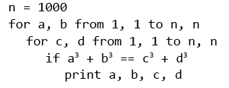
What’s duplicated?
Ex: a³ + b³ = c³ + d³ (1 <= a, b, c, d <= 1000
Duplicated: c, d pairs
c | d | c³ + d³
… | … | …
4 | 31 | 29855
4 | 32 | 32832
4 | 33 | 36001
… | … | …
5 | 59 | 205504
5 | 60 | 216125
5 | 61 | 227106
… | … | …
D

Slide 57
What’s duplicated?
Ex: a³ + b³ = c³ + d³ (1 <= a, b, c, d <= 1000
Duplicated: c, d pairs
c³ + d³ | (c, d)
… | …
29855 | (4, 31)
32832 | (4, 32), (18, 30)
36001 | (4, 33)
… | …
205504 | (5, 59)
216125 | (5, 60), (45, 50)
227106 | (5, 61)
… | …
D

Slide 58
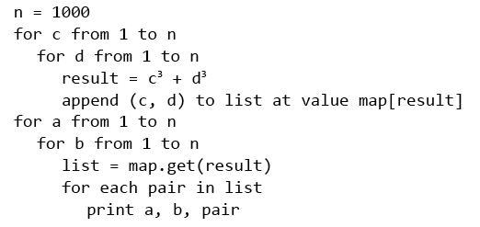
What’s duplicated?
Ex: a³ + b³ = c³ + d³ (1 <= a, b, c, d <= 1000
D

Slide 59
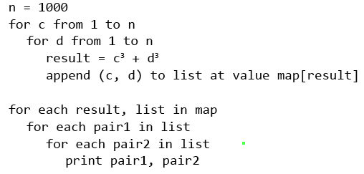
What’s duplicated?
Ex: a³ + b³ = c³ + d³ (1 <= a, b, c, d <= 1000
D

Slide 60
(B) Space/Time Tradeoffs
Hash tables & other data structures
Precomputing

Slide 61
(C) Do it yourself
Find permutations of s within b

Slide 62
find abbcd in
b | a | b | c | d | b | a | e | f | d | b | b | a | c | b | d | d | f | a | e
0 | 1 | 2 | 3 | 4 | 5 | 6 | 7 | 8 | 9 | 10 | 11 | 12 | 13 | 14 | 15 | 16 | 17 | 18 | 19

Slide 63
(C) Do it yourself
Find permutations of s within b
s = abbcd
b =
Find them!
… now how did you actually do it?
b | a | b | c | d | b | a | e | f | d | b | b | a | c | b | d | d | f | a | e

Slide 64
(D) Recursion
Use, but don’t cling to, recursion “instinct”
Try bottom-up
“Backtracking”
Draw call-tree
Derive runtime
Find repeated subproblems
Subsets of a set
{} → {}
{a} → {}, {a}
{a, b} → {}, {a}, {b}, {a, b}
{a, b, c} → …
Subsets of {S₁…S_{n-1}} + S_{n} to each

Slide 65
Techniques to Develop Algorithms
BUD
Space and Time
Do It Yourself
Recursion
Push yourself!

Slide 66

Walk Through
step
5
Know the variables
and when they change

Slide 67
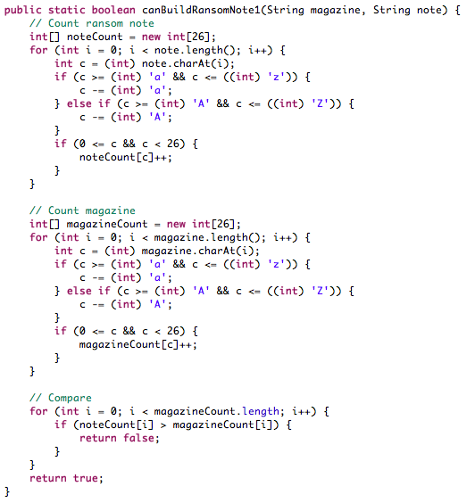
Write Beautiful Code
step
6

Slide 68
How to Write Whiteboard Code
Write straight
Top-left corner
Use arrows if needed
Error cases
Good style
Modularize (upfront!)
Language choice is up to you!

Slide 69
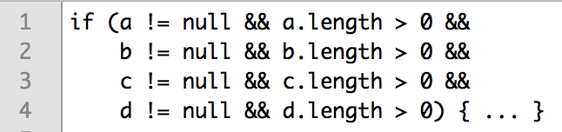
Error Cases
Good to check errors / boundaries!
But consider the time…

Slide 70
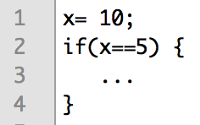
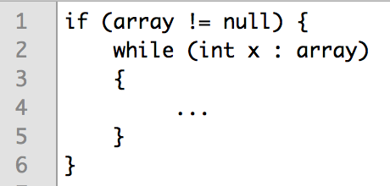
Good Style
Spacing, line breaks, variable names

Slide 71
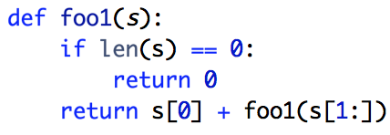
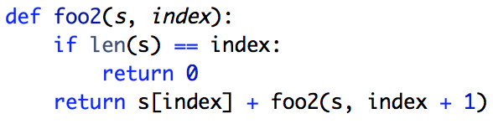
Language Choice
Java, Objective C, etc: Abbreviate
Python, Ruby, JS, etc: Careful with built-in functions

Slide 72
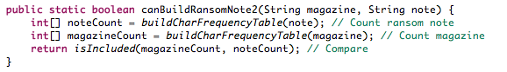
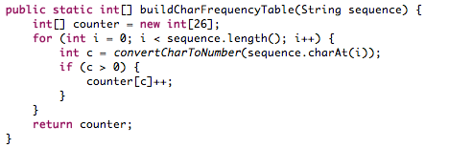
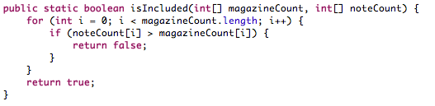
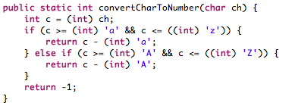
Modularization

Slide 73
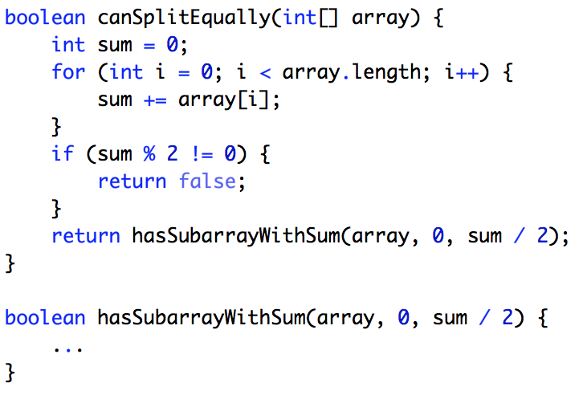
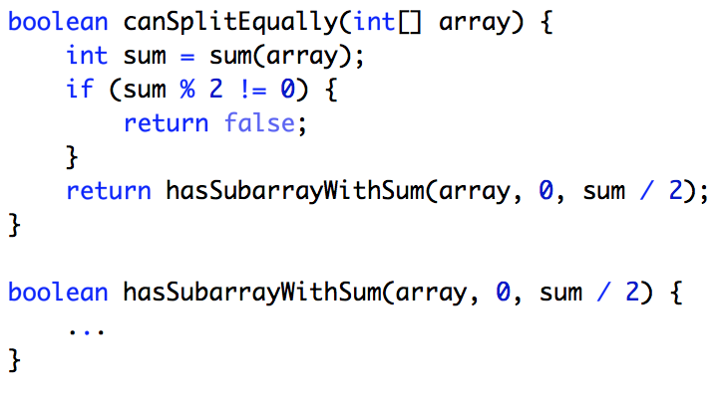
Modularize (Upfront!)
I’ve learned nothing.

Slide 74
Testing
Find permutations of s within b:
s = abbc
b = babcabbacaabcbabcacbb
for (i = 0; i < b.len – s.len; i++) {
if (isPerm(s, b.subs(i, s.len)) …
}
FIRST Analyze
What’s it doing? Why?
Anything that looks weird?
Error hot spots
THEN use test cases
Small test cases
Edge cases
Bigger test cases
BUT…
Test code, not algorithm
Think as you test
Think before you fix
step
7

Slide 75
How
To
CrackingTheCodingInterview.com → “Resources”
Approach
Email: g@gayle.com Subject: fbprep

Slide 76
Email: g@gayle.com Subject: fbprep
Questions for Your Interviewer
05
What do you want to know?

Slide 77
Prepare some questions
What’s made you happy / unhappy?
What are your goals?
Culture & work style
Career paths
Technology
Interviewer’s experience

Slide 78
Email: g@gayle.com Subject: fbprep
Final Thoughts
06
And questions

Slide 79
Be a great teammate.
It’s done
for a
reason!
Be a great engineer.

Slide 80
But wait, there’s one more thing...
Email: g@gayle.com Subject: fbprep
READY? Follow up with your recruiter to schedule your next steps.
JOB POSTINGS: facebook.com/careers/teams/engineering
SLIDES? Gayle.com -> Events -> search “Facebook”

Slide 81
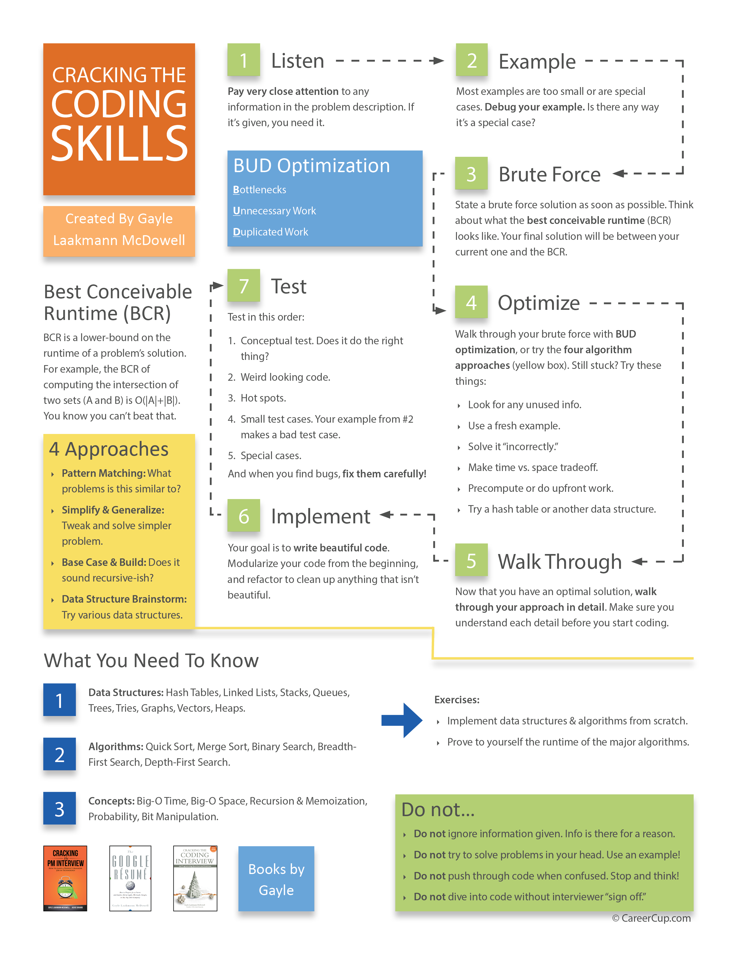

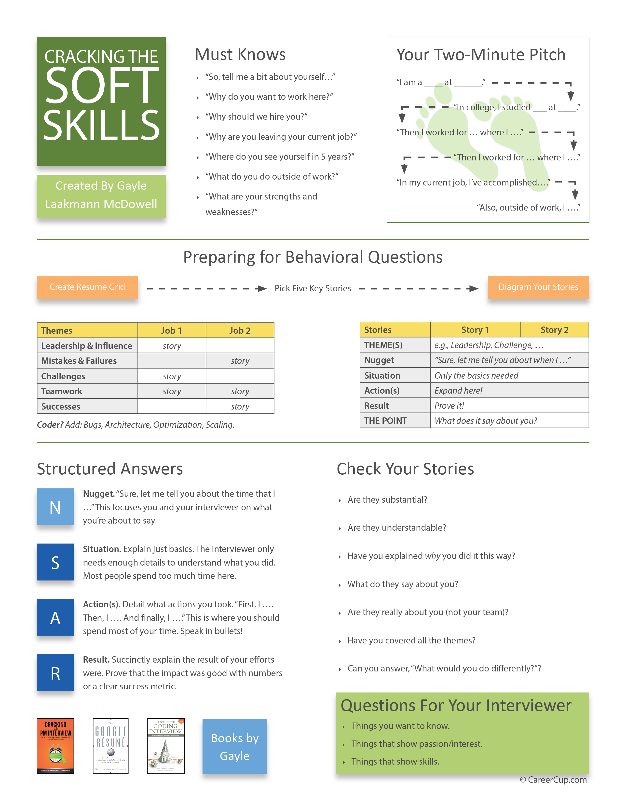
Other Resources
Gayle.com CareerCup.com
CrackingThe CodingInterview.com
Or, follow me online
facebook.com/gayle
twitter.com/gayle
gayle.com
gayle@gayle.com
quora.com
Email: g@gayle.com Subject: fbprep

